Slide 1








Joint Collaborative Event
VIRTUAL 12TH INTERNATIONAL PROJECT COMPETITION AND EXHIBITION 24.02.2022
Smart Waste Management
Geethika S M
Indhu Rekha U
Subrajashree D
College Name : Bannari Amman Institute of Technology, Sathyamangalam
Reference Number :201021

Slide 2


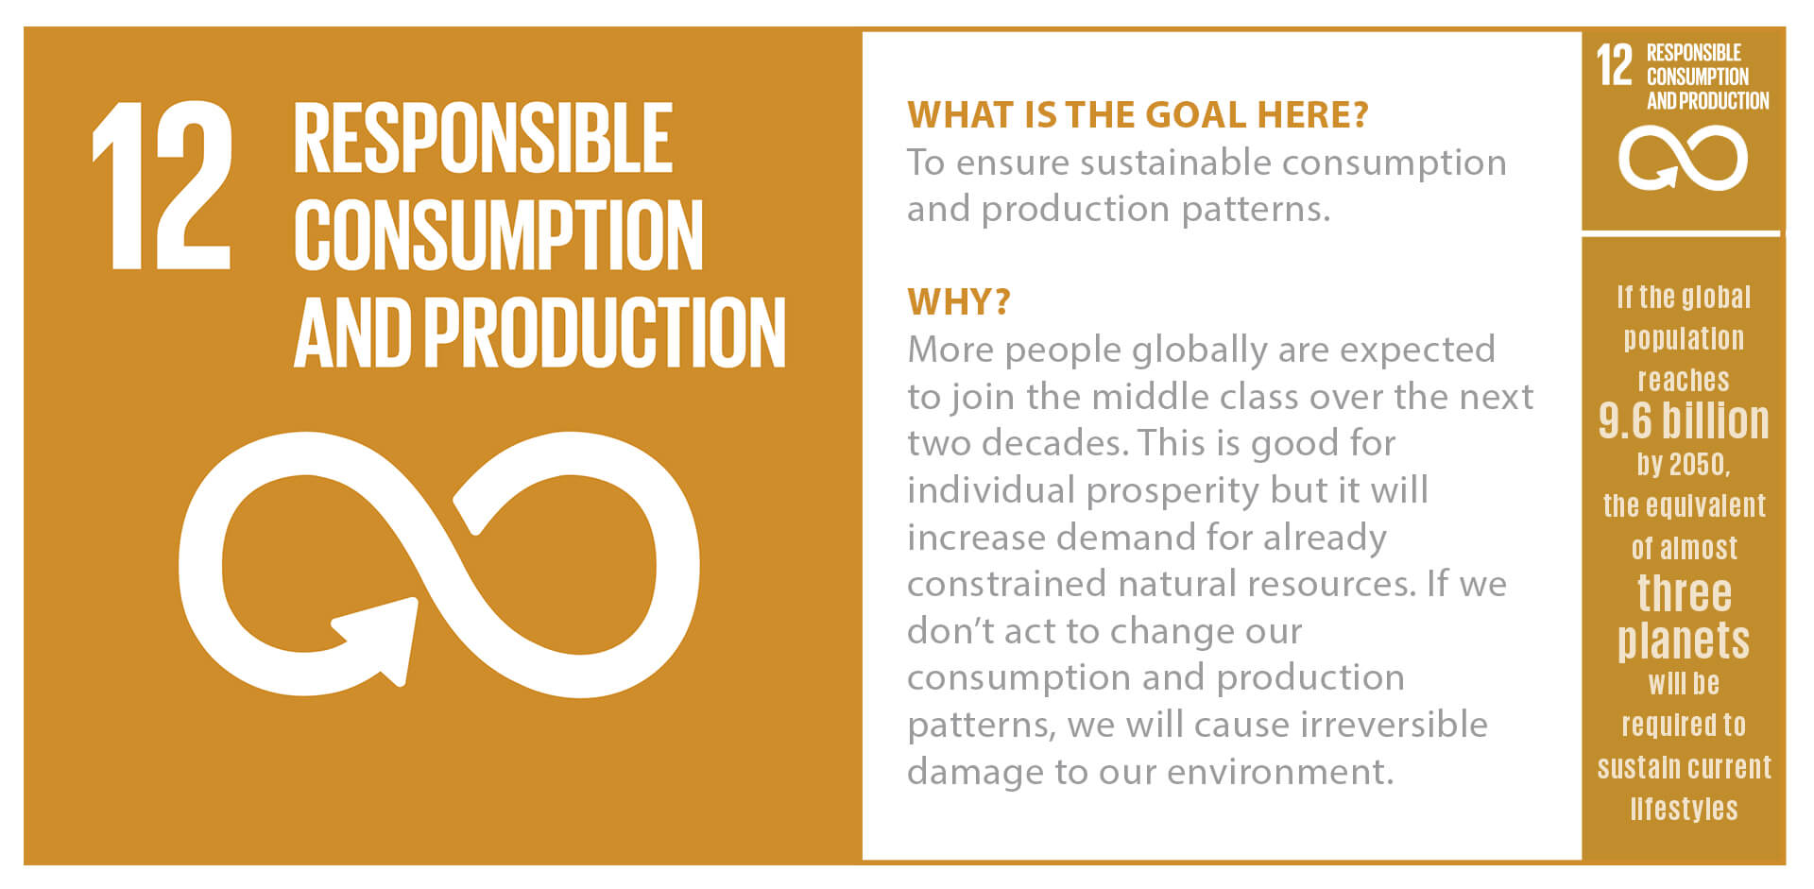
Index
1
Project Details/Problem Statement
2
Concept of the Solution
3
Novelty / Scope of Solution
4
Pros and Cons of the solution
5
Technical Description
6
Implementation Plan or Working Model (as the case may be)
7
Validation/Testing/Analysis
8
Cost Estimate (If needed)
9
Justify reasons for special category awards
10
References

Slide 3
Problem Statement
If waste is dumped in the dustbin for a long time, hazardous gasses are produced by which toxicity level increases.
Hence, public people, especially sweepers and cleaners, are prone to diseases.
2/3rd of total deaths are due to stroke, cancer, and respiratory disease.
2.6 million deaths every year are caused due to unhealthy environments.
We measures the toxicity level of waste
To Reduce the over-dumping by sending the garbage bin information to the authorities and drivers through mobile applications.
It intimates the people where the next closest dustbin is available for use.
To avoid hazardous diseases and create a clean and healthy environment.

Slide 4
Concept of the solution
Once if the garbage bin is filled above threshold (80% of total volume – can be adjusted), it informs to the authorities and truck drivers via mobile application.
This app provides the location of various nearby garbage using which the municipal corporation will be aware of an overflow of garbage earlier
App shows the toxicity and indicates the level of toxic gas in the respective garbage.

Slide 5
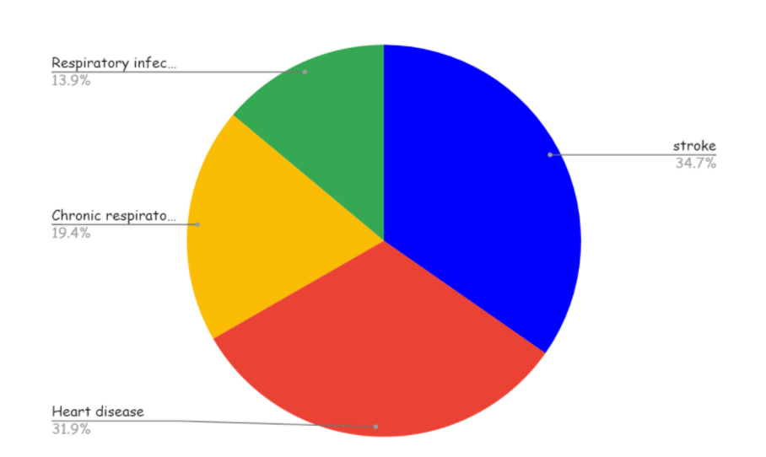
Novelty / Scope of Solution
Authorities are not intimated properly or they aren't aware of the level of dustbins whether it has filled or not.
We have made field survey
Through this mobile application, we intimate the authorities to clear the waste once the bins are filled
We measure the toxicity of waste to ensure whether it can be used for recycling.
We display the near the bins is to make people aware not to over dump and also to search for other bins for disposal of waste.
Statistical reports indicate that India produces nearly 42 million tons of solid waste per year and also the report for the presence of toxic gases in the solid waste and graphical representation of death rate due to the unhealthy environment is given below.
State | Amount of waste produced
Ahmedabad | 6.3 million
Bangalore | 8.4 million
Chennai | 8.6 million
Delhi | 16.4 million
Mumbai | 18.1 million
Hyderabad | 7.7 million
Kolkata | 14.1 million
Major Constituents | Percentage
Methane | 30% - 60%
Carbon-dioxide | 34% - 60%
Nitrogen | 1% - 21%
Oxygen | 0.1% - 2%
Carbon monoxide | 0 - 0.2%
Hydrogen | 0 - 0.2%
Ammonia | 0.1% -1%

Slide 6
Pros and Cons of the solution
Pros of the solution:
We have done field survey to analyse the problem statement from the works.
With the use of two threshold levels, the authority can dispose of the garbage bin before it gets overfilled
The authorities will be notified about the harmful gasses and fill the garbage bin with the location.
Display screen available above the dustbin helps the people to search for new bin
It ensures good health to workers in the landfill area.
Transporting waste to the location where it is safe and without threatening the animals or any other species and also the environment
Cons of the solution :
The process is not always economical if the bins are located in villages.
Segregation of biodegradable and non-biodegradable is possible with high cost.
The resulting recycled product is unlikely to be of long-term value

Slide 7
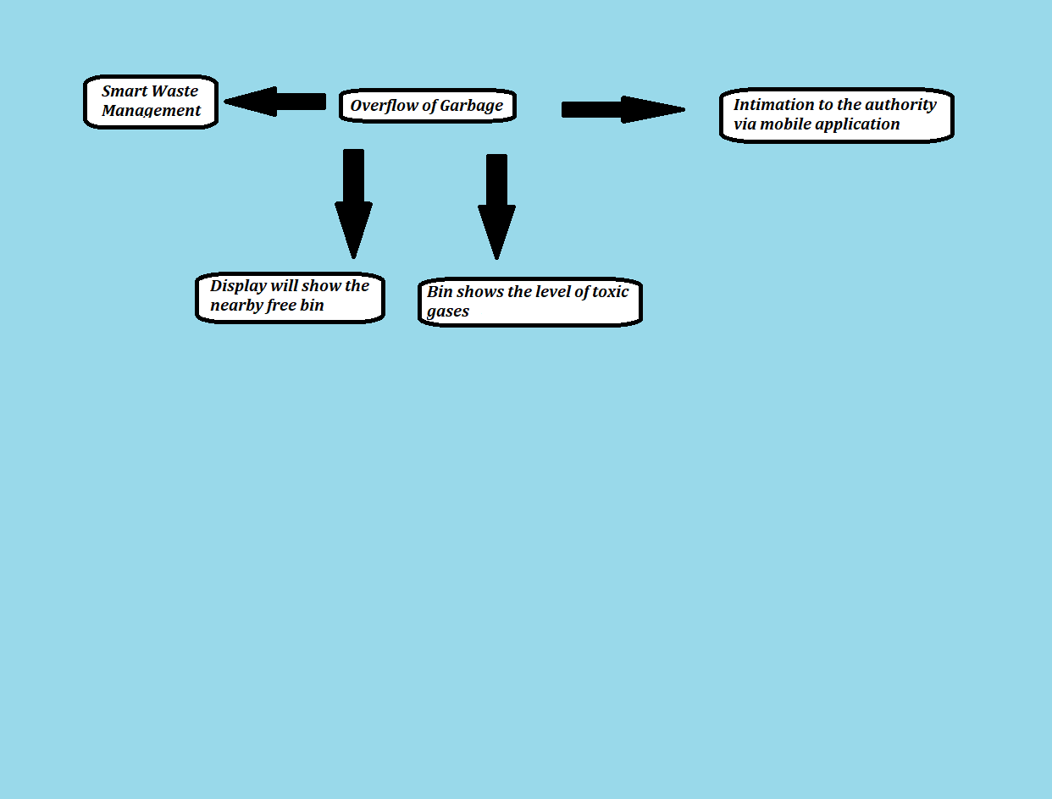
Technical Description
Technical Description Of the project by the flow chart

Slide 8
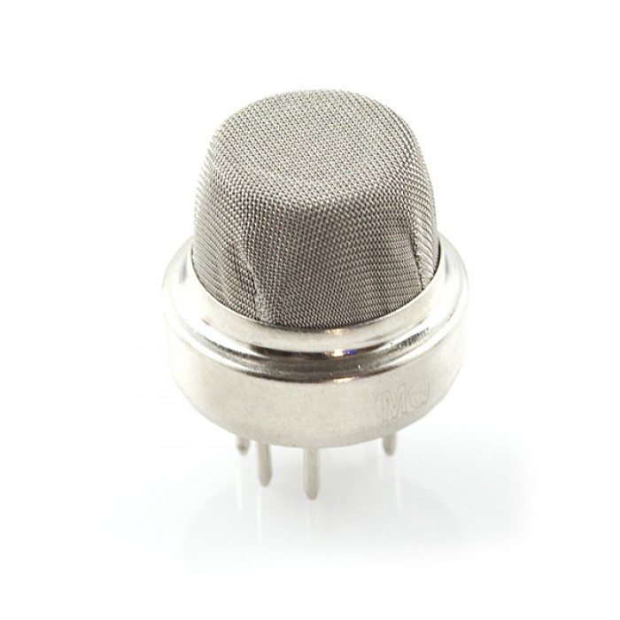
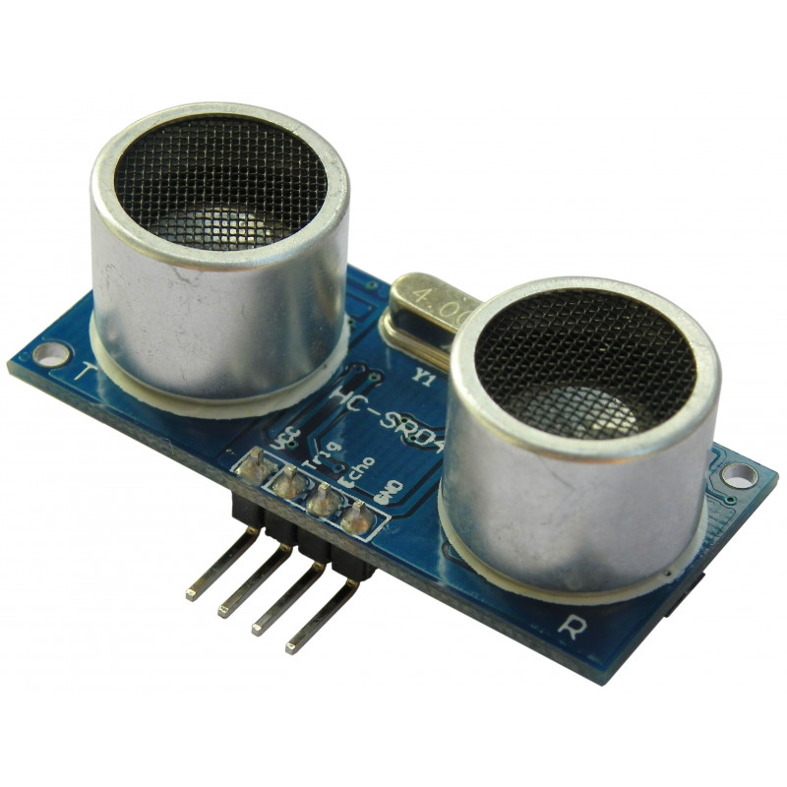
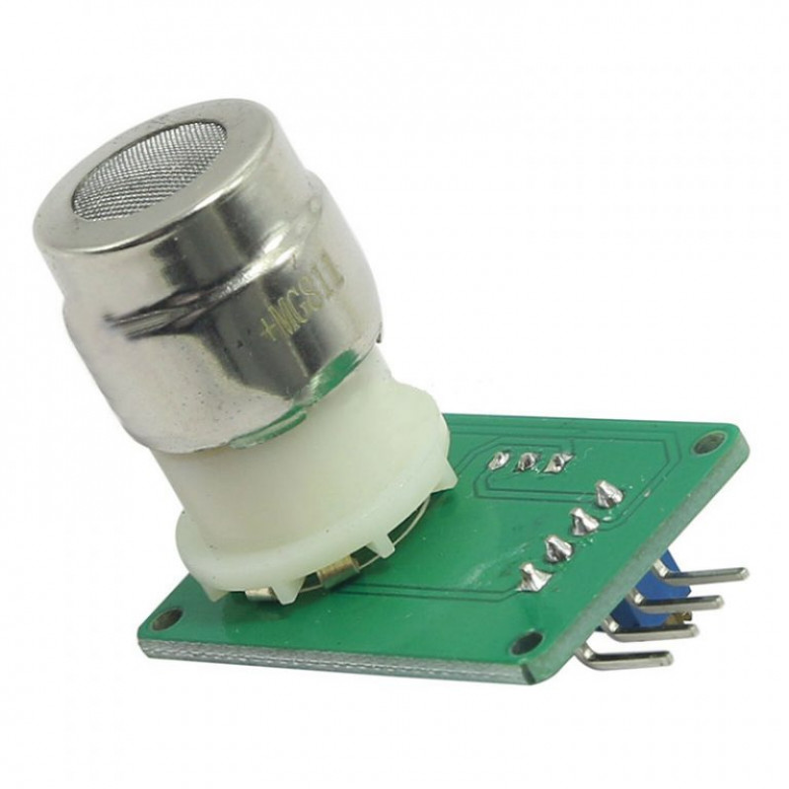
Implementation Plan/Working Model
Ultrasonic sensors are used to identify the level of garbage in the bin.
Once the threshold level is reached ,the intimation is sent to the authority via mobile application.
The gas sensors( Mq4 methane gas sensor and Mg811\SCD40 for measuring CO2) are used to identify the toxic gases in the bin.
MQ4 Methane Gas Sensor detects the concentration of methane gas in the air and outputs its reading as an analog voltage. The concentration sensing range of 300 ppm to 10,000 ppm is suitable for leak detection. For example, the sensor could detect if someone left a gas stove on but not lit. The sensor can operate at temperatures from -10 to 50°C and consumes less than 150 mA at 5 V.
MQ4 Methane gas sensor CO2 gas sensor Ultrasonic sensor

Slide 9
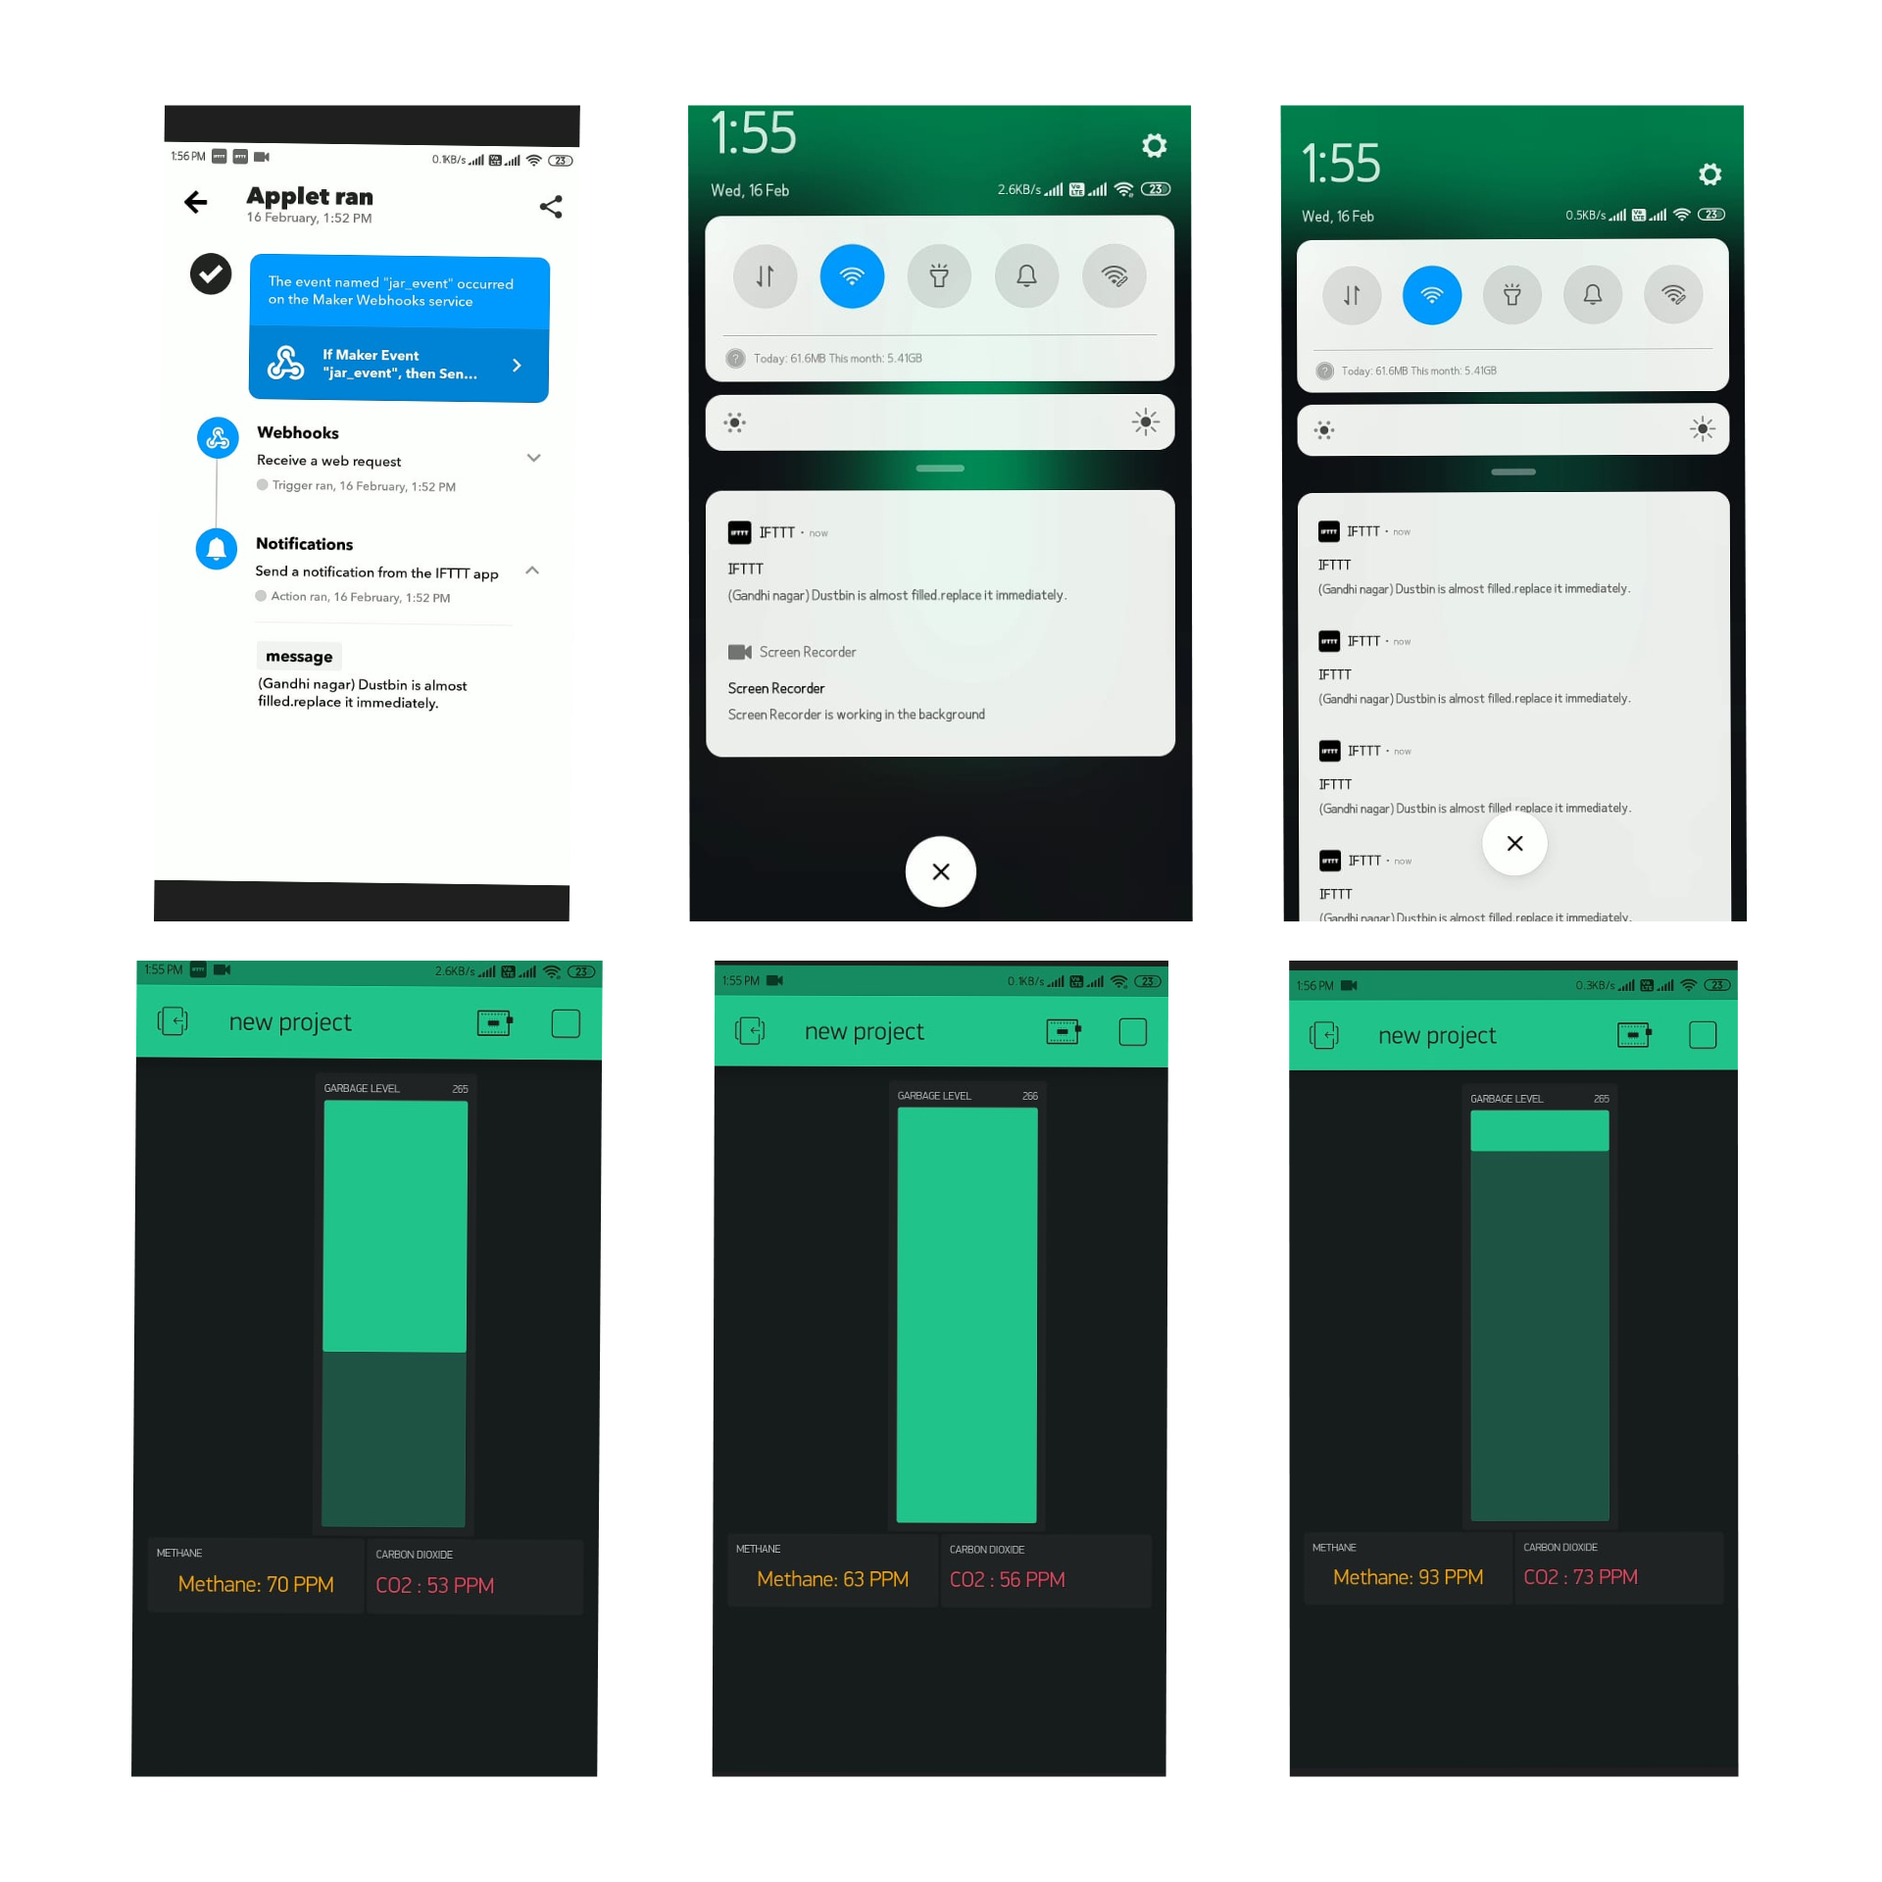
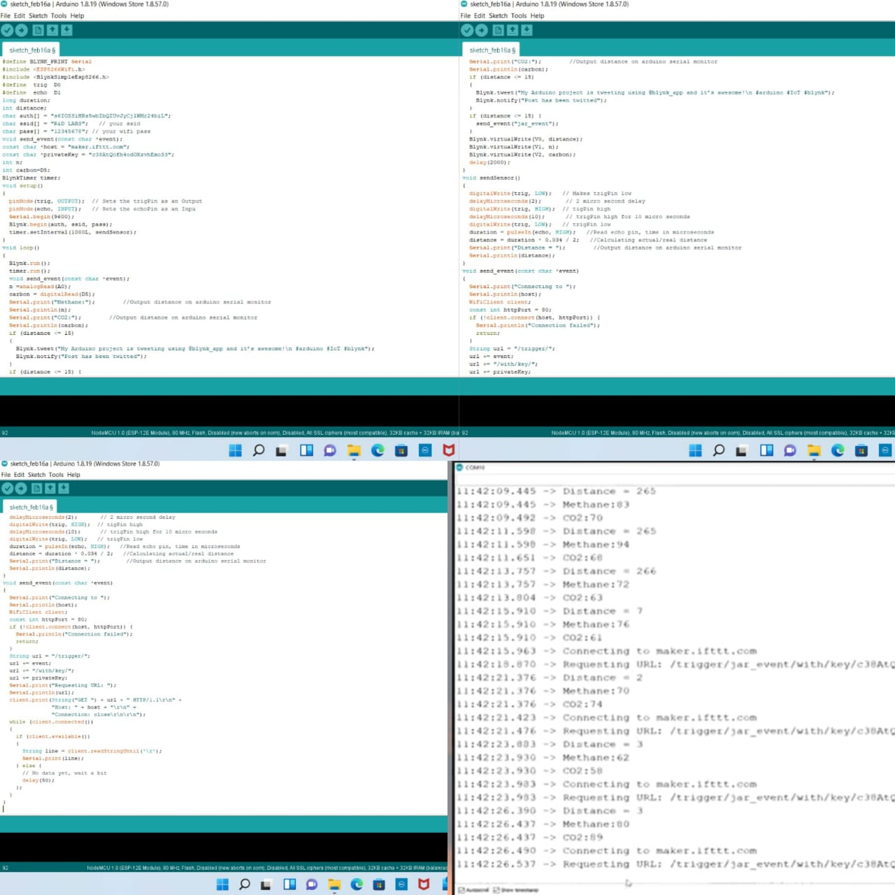
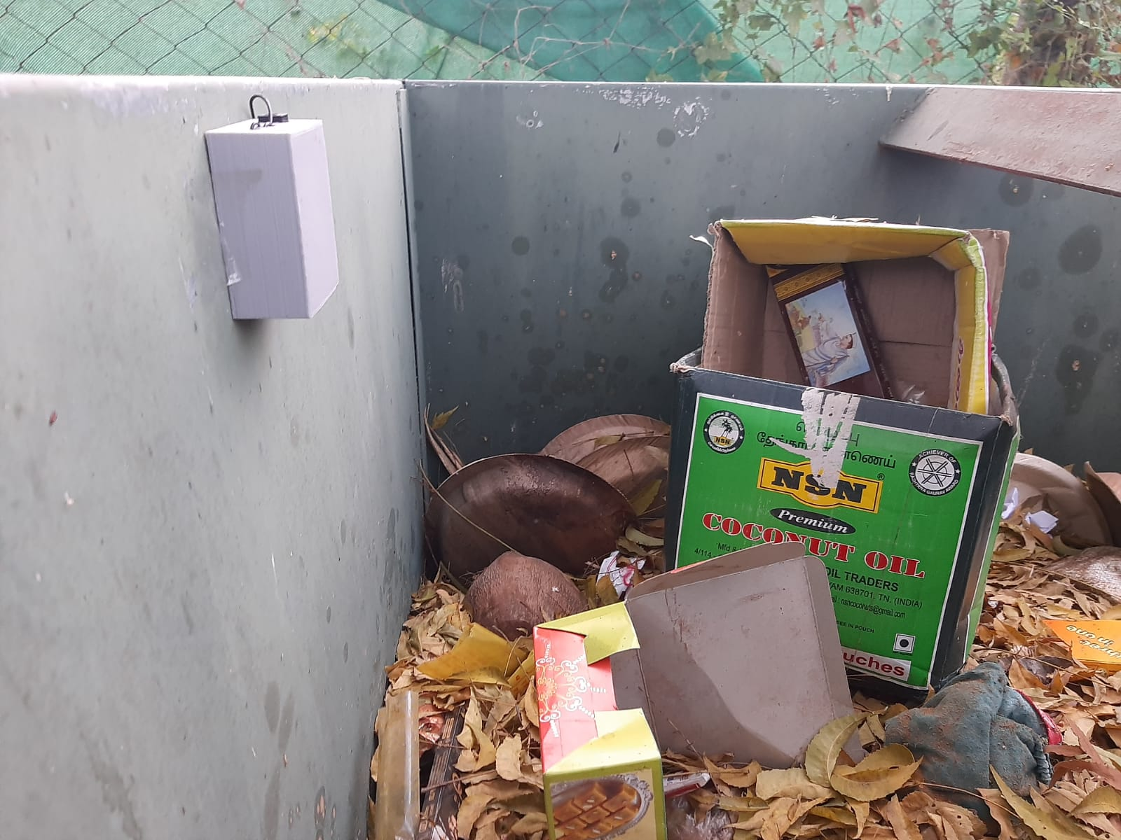
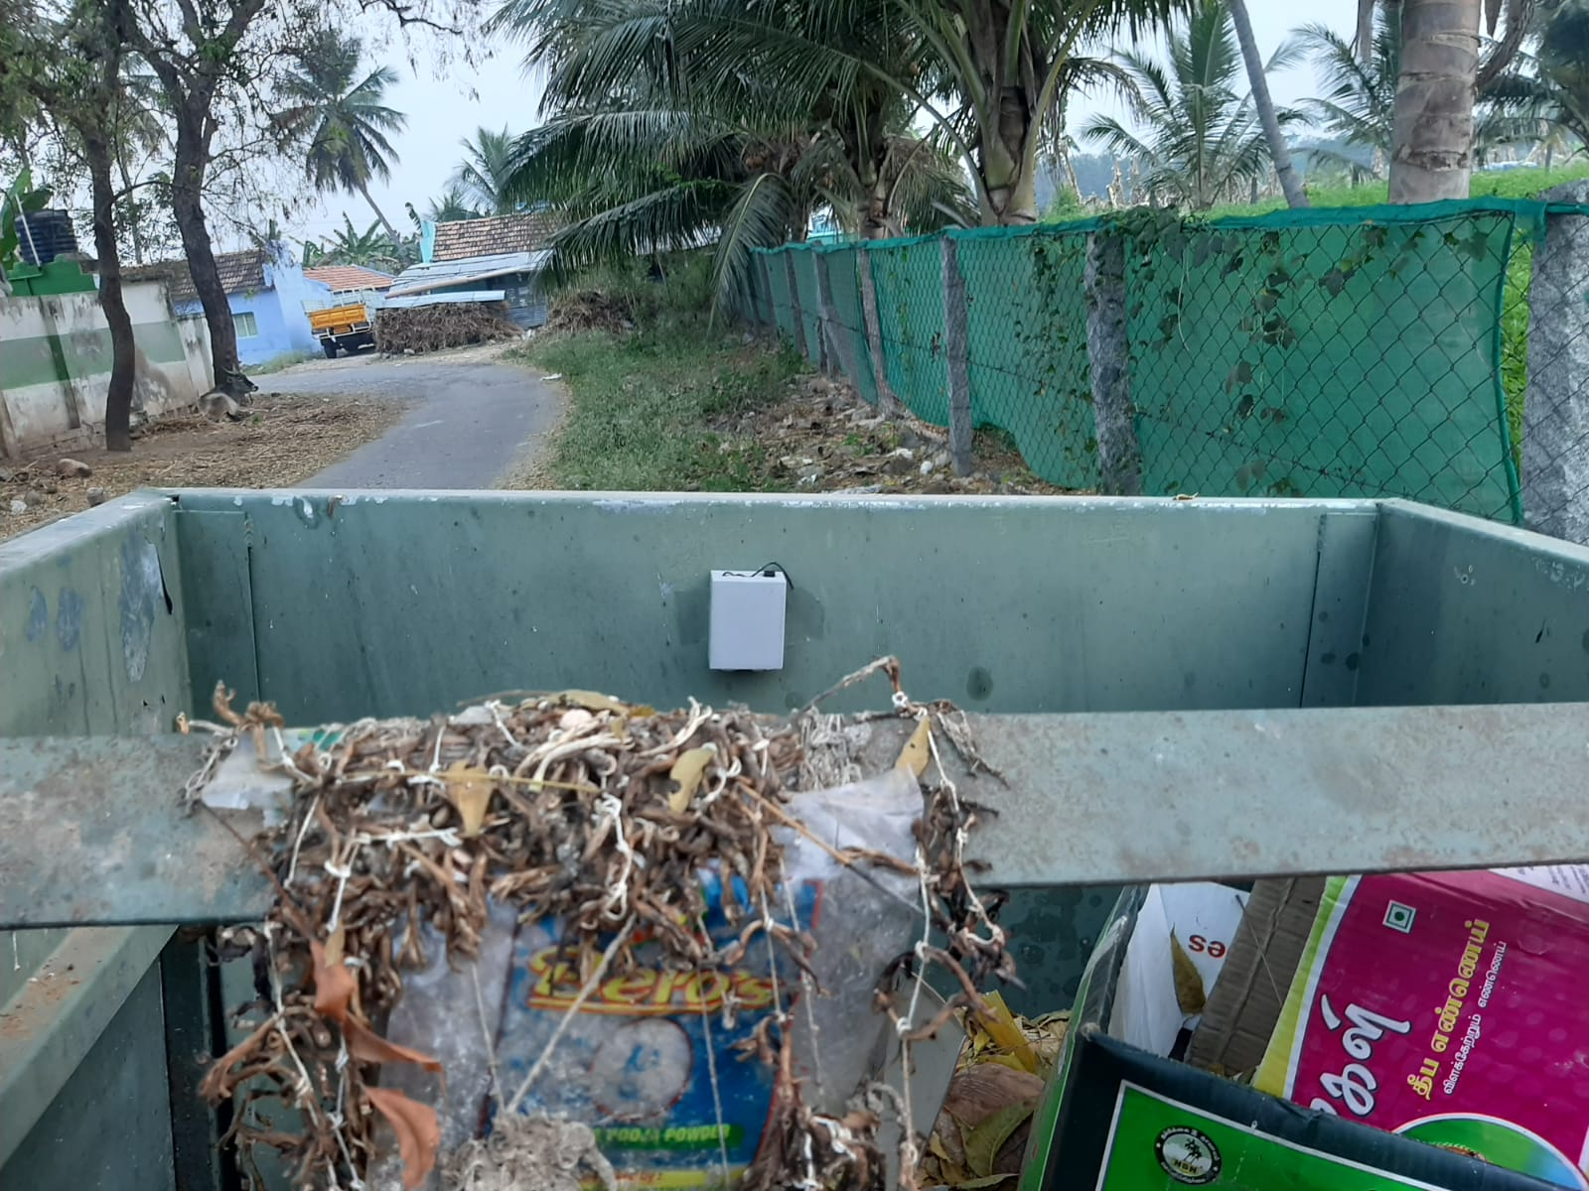
Validation / Testing / Analysis
Working model of the application Code and the Output Field Implementation

Slide 10
Cost Estimate(if required)
Cost of the sensors:
Cloud usage local server- monthly 150
IoT Controller- 395
MQ 135
Methane Mq4 – 89
Total = (800 Aprox)
The sensors and components used in this project is cost-efficient and affordable

Slide 11
Justify reasons for special category awards
To which category your project will ideally match with any one of the following special categories to claim the respective award also( i.e .Apart from theme wise Best Prizes):Choose any one repeat one category only and specify reasons :
Best start up idea/Business Potential award ,
Best Interdisciplinary award,
Best Innovation award,
Best Environment Sustainability award,
Best Measurable award,
Best Prototype award,
Best Scalability Innovation award,
Best Team Work award,
Best Video Making award,
Encouragement prize award,

Slide 12
References
1.https://www.who.int/news/item/15-03-2016-an-estimated-12-6-million-deaths-each-year-are-attributable-to-unhealthy-environments
2.https://www.who.int/news-room/fact-sheets/detail/health-care-waste
3.https://www.statista.com/topics/4983/waste-generation-worldwide/#dossierKeyfigures
4.https://www.niti.gov.in/sites/default/files/2021-12/Waste-Wise-Cities.pdf
5.https://timesofindia.indiatimes.com/india/in-30-years-india-tipped-to-double-the-amount-of-waste-it-generates/articleshow/74454382.cms

Slide 13

THANK YOU

